Slide 1
ECG Signal Processing
BEVD2023L Signal Processing
TEAM MEMBERS :
NAME REGISTER. NO
Noel Jose 23BVD1029
SANJAY A 23BVD1012
DRAHVIDAN Chittarasan 23BVD1050
Joseph SantHosh 23BVD1009

Slide 2
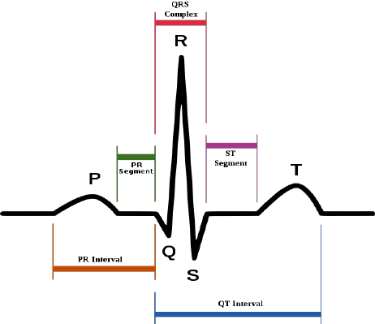
Introduction
Electrocardiogram (ECG) is a signal that describes
the electrical activity of the heart. The ECG signal is
generated by contraction (depolarization) and relaxation
(repolarization) of atrial and ventricular muscles of the
heart. The ECG signal contains- a P wave (due to atrial
depolarization), a QRS complex (due to atrial repolarization
and ventricular depolarization) and a T wave (due to
ventricular repolarization).

Slide 3
AIM
To observe the ECG signals taken from the database of a MIT-BIH Arrhythmia patients.
To perform the pre-processing required to remove the Artifacts from the ECG signal using filtering method.
To detect the PQRST waves of ECG signal and determine the heartbeat of a patient.

Slide 4
Data Set
Database used in this project is a standard data taken from MIT-BIH Arrythmia Database.
Database is observed using two-channel ambulatory ECG recordings and it is obtained from 47 subjects studied by the BIH Arrhythmia Laboratory between 1975 and 1979.
ECG signal is recorded for 10 seconds, and sampling frequency used is 360Hz with a voltage gain of 200.

Slide 5
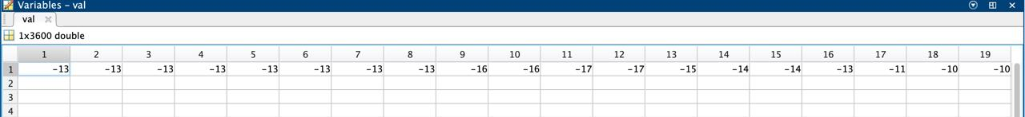

Slide 6
Removal of Artifacts from ECG Signal
Removal of Baseline Wander
It can be removed using Discrete Wavelet Transform (DWT). The frequency content of the baseline wander is in the range of 0.67Hz. It will require nine-level decomposition of original signal using DWT to remove the baseline wander of required frequency.
Removal of Powerline Interference
It can be removed using a notch filter concentrated at 50Hz with a 3-dB bandwidth of 5Hz.
Removal of EMG – High Frequency Noise
It can be removed using Discrete Wavelet Transform (DWT). Most of the information available in the ECG signal lies in the range of 0.5-150 Hz. It will require two-level decomposition of original signal using DWT to remove the high frequency noise.

Slide 7
Discrete Wavelet Transform
Discrete Wavelet Transform (DWT) decomposes a signal into a set of mutually orthogonal wavelet basis functions. Wavelet functions are dilated, translated and scaled versions of a common function φ, known as the mother wavelet.
DWT has the ability to perform frequency resolution as well as temporal resolution i.e., it can provide information about the frequency components of the wave and its location.
There are several families of wavelet transforms which are identified by their mother wavelet, most common are Haar, Shannon, Daubechies, Spline, Biorthogonal, Mexican hat, etc.
In this project, for the removal of artifacts from the ECG signal, we have used Biorthogonal wavelet transform whereas for the detection PQRST waves in the ECG signal, we have used Daubechies wavelet transform.

Slide 8
To perform the DWT, input signal is given to a low pass filter to obtain the approximate coefficients and simultaneously input signal is also given to a high pass filter to obtain the detailed coefficients.
Detailed coefficients are fixed but approximate coefficients can be modified.
To perform further decomposition of input signal into higher scales, approximate coefficients are down sampled by the factor of 2 and given to another set of high pass and low pass filter to obtain the level 2
approximation and detailed coefficients.
In this project, for the removal of baseline wander noise, we are required to perform nine-level decomposition whereas for the removal of EMG noise, we are required to perform two-level decomposition of the ECG signal.

Slide 9
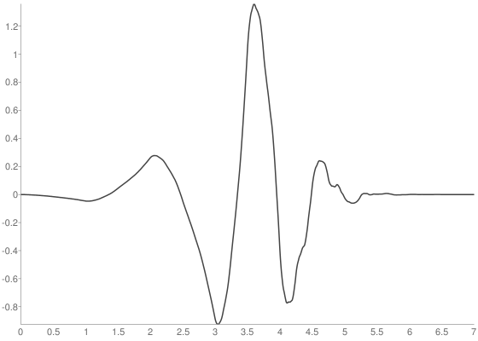
Daubechies Wavelet
Daubechies wavelet was chosen for this project on the basis
of the resemblance and similar frequency response
characteristics of the DB4 basis function with the ECG waveform.
Daubechies4 (db4) wavelet belongs to asymmetric, orthogonal,
biorthogonal and compactly supported families of wavelet.

Slide 10
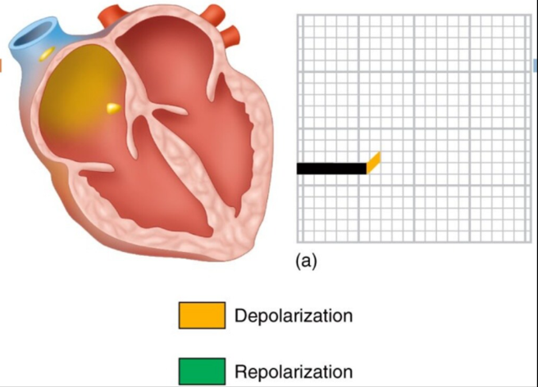
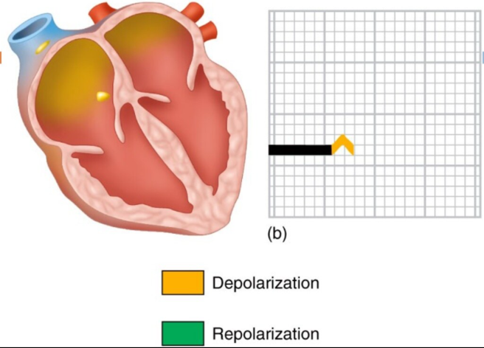
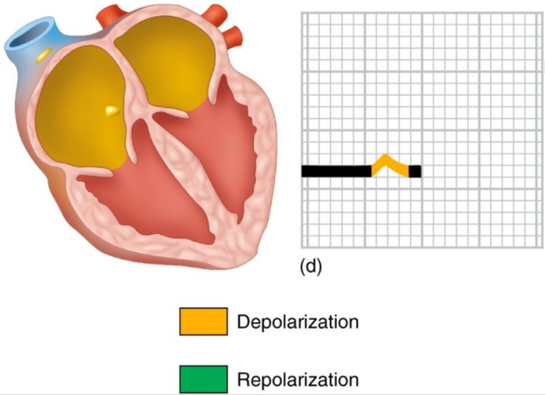
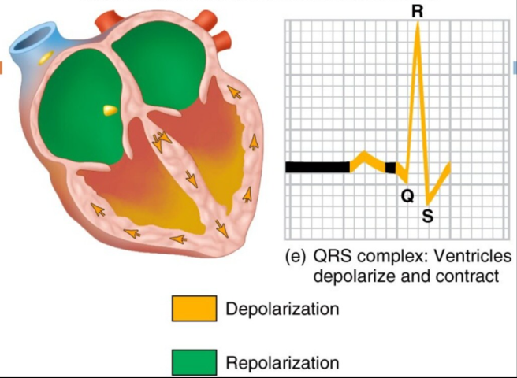
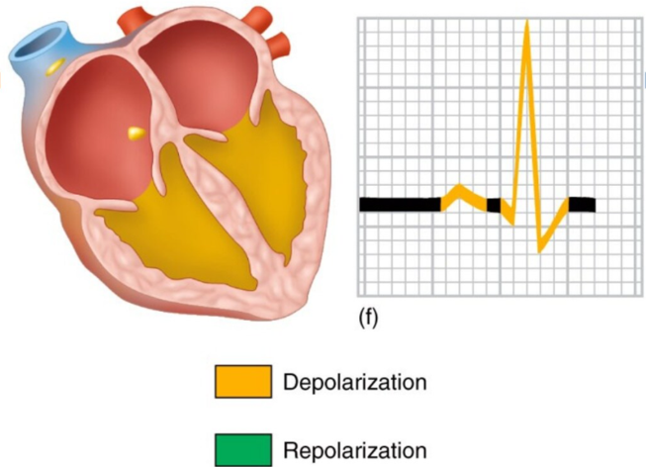
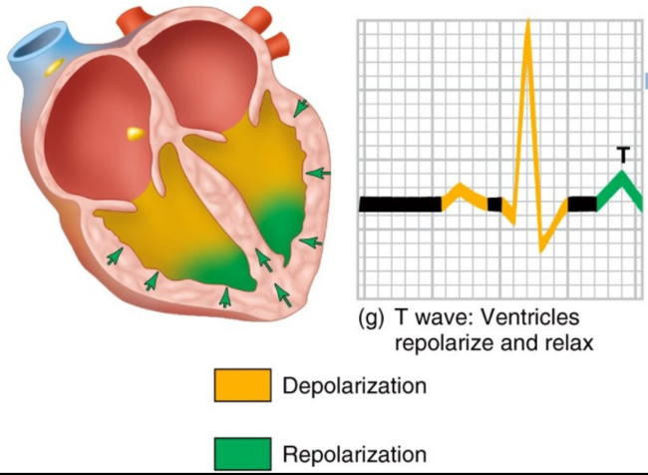
Generation of PQRST Waves

Slide 11
MATLAB CODE

Slide 12
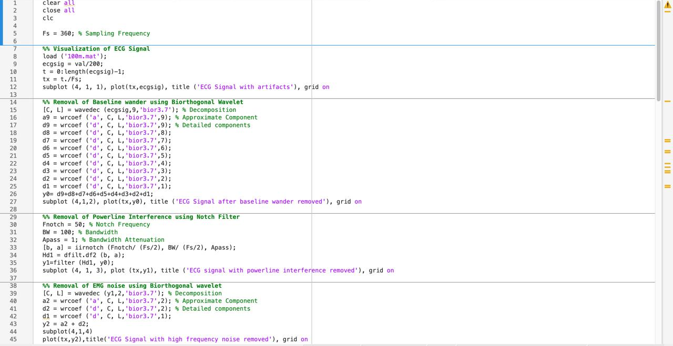

Slide 13
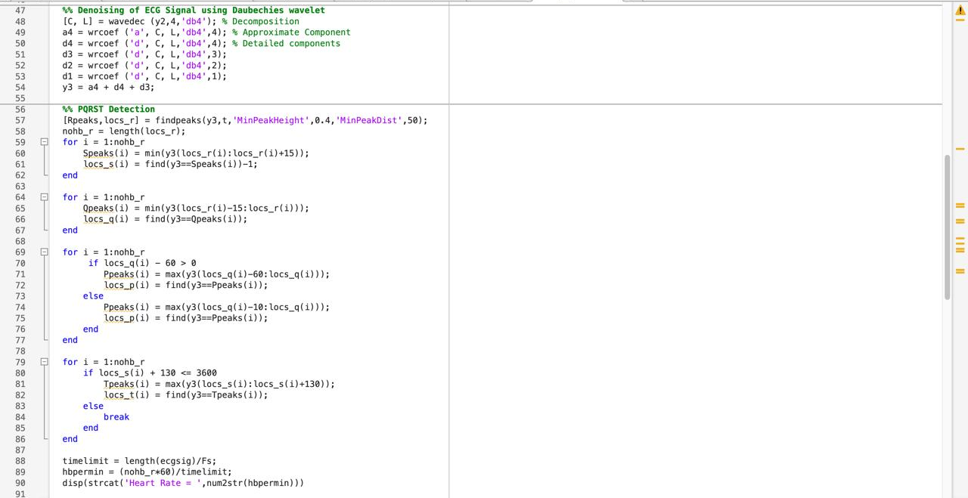

Slide 14
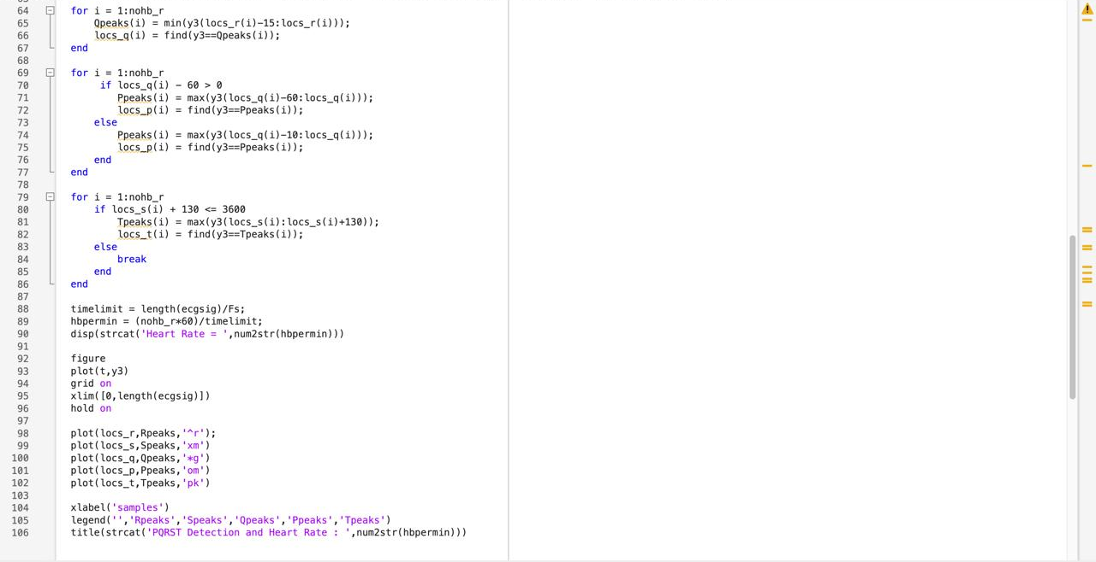

Slide 15
OUTPUT WAVEFORMS

Slide 16
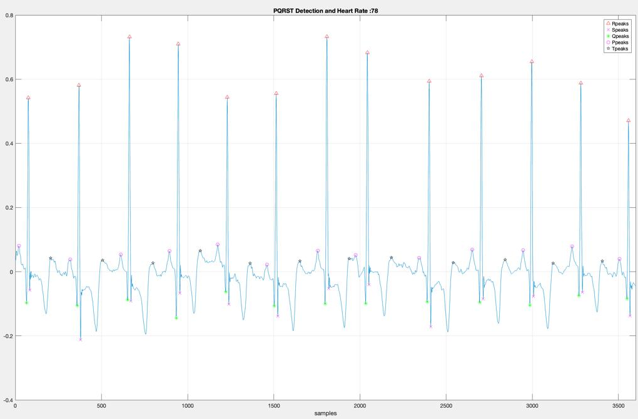

Slide 17
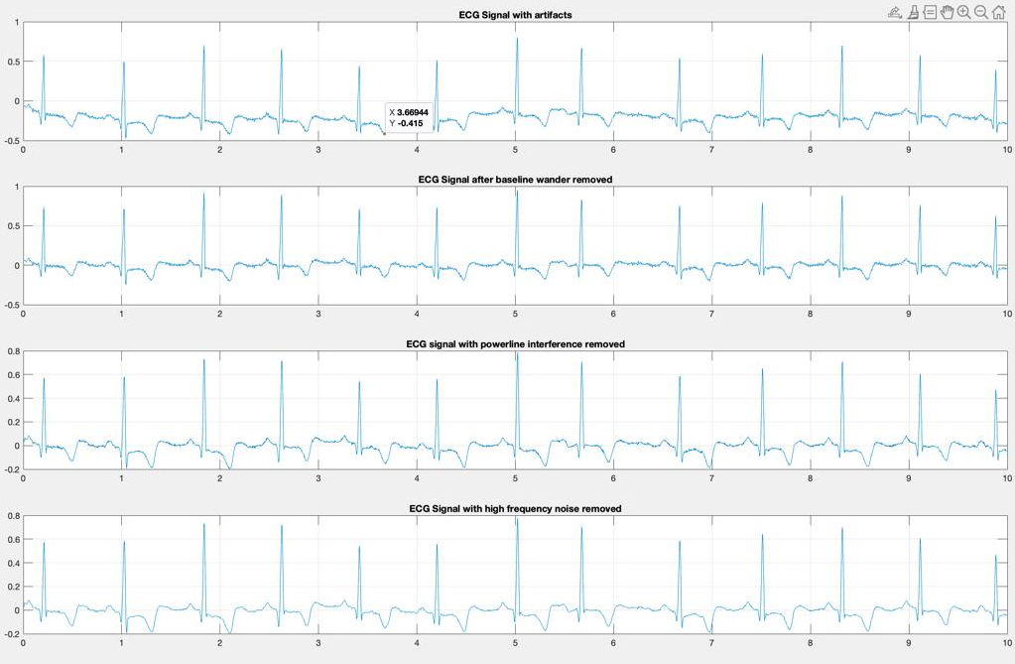

Slide 18
Scope and Limitation of the study
In this study, we have used discrete wavelet transform for denoising ECG signals. Discrete Wavelet Transform (DWT) is a transformation that can be used to analyze the temporal and spectral properties of linear and non-stationary signals like audio but almost all real signals are non-linear.
Therefore, denoising of ECG signals can be done using Empirical Mode Decomposition (EMD) technique.
Another limitation is the use of notch filter for the removal of powerline interference. So, one can use discrete wavelet transform based on component retrieval technique.

Slide 19
FUTURE SCOPE
1. Real-Time ECG Monitoring
Objective: Extend the current framework to support real-time ECG signal processing.
Approach:
Integrate the system with a real-time data acquisition device (e.g., AD8232 or BMD101).
Optimize algorithms to work with streaming data using MATLAB or Python-based real-time systems.
Applications:
Continuous patient monitoring in intensive care units (ICUs).
Remote health monitoring using wearable ECG devices.

Slide 20
2. Advanced Noise Removal
Objective: Improve the noise removal process for better signal clarity.
Approach:
Use adaptive filtering techniques to dynamically cancel noise based on statistical properties.
Employ deep learning-based denoising autoencoders for more accurate artifact removal.
Applications: Enhanced preprocessing for noisy environments like ambulances or mobile health applications.

Slide 21
3. Integration with Wearable Devices
Objective: Adapt the system for wearable devices for continuous monitoring.
Approach:
Optimize algorithms for low-power microcontrollers (e.g., Arduino, ESP32).
Develop an app interface to visualize ECG and heart rate trends.
Applications:
Fitness tracking and recovery monitoring.
Long-term cardiac health management for at-risk individuals.

Slide 22
THANK YOU

